Slide 1
Dancing to Music
Han Yan, Weiyu Du
CIS 565 Final Project Presentation

Slide 2

Project Overview
Given a piece of music, generate a dance sequence that matches both the beats and style of the music
Deep Learning: Neural network
Decomposition: decompose dance sequence, learn to generate movements
Composition: learn to generate movements according to music
[1] Lee, H.Y., Yang, X., Liu, M.Y., Wang, T.C., Lu, Y.D., Yang, M.H., Kautz, J.: Dancing to music. In: NeurIPS (2019)

Slide 3
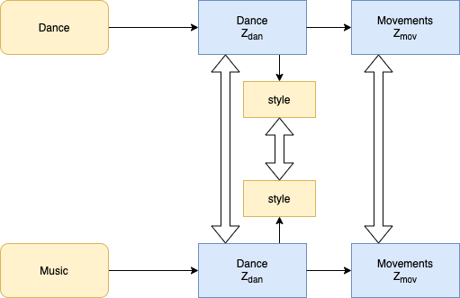
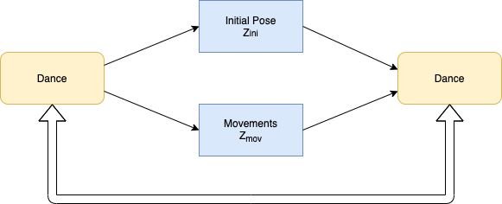
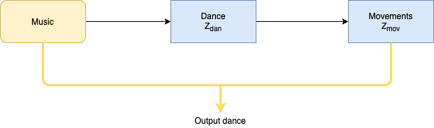
Composition Stage
Decomposition Stage
Inference Stage
Data flow
Loss constraints

Slide 4
Decomposition Stage
Decomposition Stage
Inference Stage
Data flow
Loss constraints

Slide 5
Decomposition Stage
Composition Stage
Inference Stage
Data flow
Loss constraints

Slide 6
Decomposition Stage
Composition Stage
Data flow
Loss constraints

Slide 7
Our improvements
Experiments and ablation studies to check the effectiveness of each module:
Poor music style classification, indicating poor ability in capturing music feature
Removing style regressor in the model does not affect generation quality
Conclusion: Music style understanding is the current bottleneck
Improvements:
Trained a model for each of the music category
Redesigned network for style extraction
Notes:
We did a number of experiments to check the effectiveness of each module in the network.

Slide 8

Results
Notes:
We did a number of experiments to check the effectiveness of each module in the network.

Slide 9
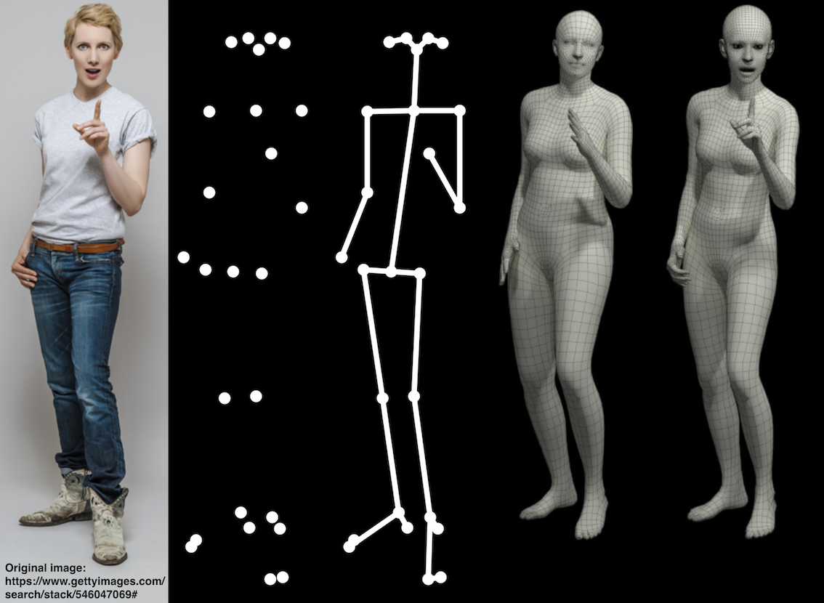
Limitation and future work
Limitation:
Generation results limited to training categories
Some dance movements lack diversity
2D stick figures fail to capture details that are crucial to dance performance, such as facial expression, hands, feet
Future work:
Extract more information as training input from raw dance videos
Use parametric body models, such as SMPL, SMPL-X
SMPL eXpressive, Pavlakos et al.
Notes:
We did a number of experiments to check the effectiveness of each module in the network.

Slide 10
Thank you!
Han Yan, Weiyu Du
hyan99, weiyudu@seas.upenn.edu

